Slide 1


Jirone
Digitizing the Campus Dining Experience at ADTU
Seamless Ordering • Real-time Tracking • Cashless Payment

Slide 2


The Current Challenge
Congestion & Delays
Manual Inefficiency
During peak hours, canteen queues become unmanageable. Students spend their limited break time waiting in line rather than eating, leading to frustration and lost revenue.
Cash handling slows down service. Manual order tracking leads to errors, "lost" tickets, and difficulty in managing kitchen inventory across different blocks (A, B, J, K).

Slide 3

The Solution
A smart, block-specific web application

Slide 4

The Student Journey
Scan & Select
Add to Cart
Secure Pay
Track & Eat
Student scans QR code at their table or selects their specific Block (A, B, J, K).
Browse menu with Veg/Non-Veg filters and search. Add items to cart.
Pay instantly via Razorpay (UPI/Card) or choose Pay at Counter.
Receive email invoice. Watch status change from "Pending" to "Ready".

Slide 5
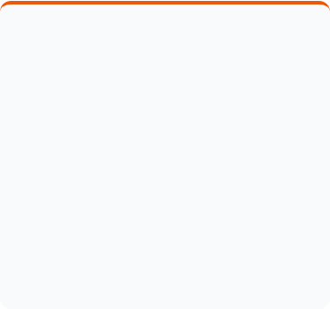
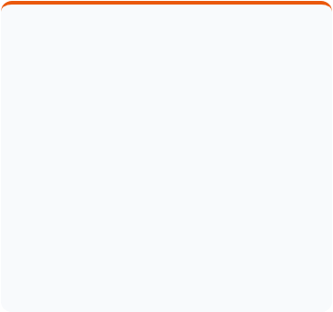
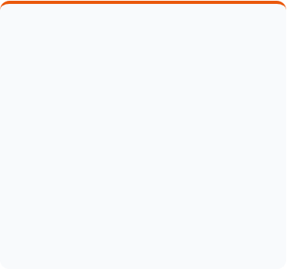


Student-Centric Features
Block Filtering
Real-Time Status
Auto-Invoicing
Menu items are dynamically filtered based on the student's location (Block A, B, J, or K), ensuring relevant availability.
Powered by Firestore real-time listeners, students see order status updates instantly without refreshing the page.
Automated PDF receipt generation sent directly to the registered email via EmailJS integration.

Slide 6
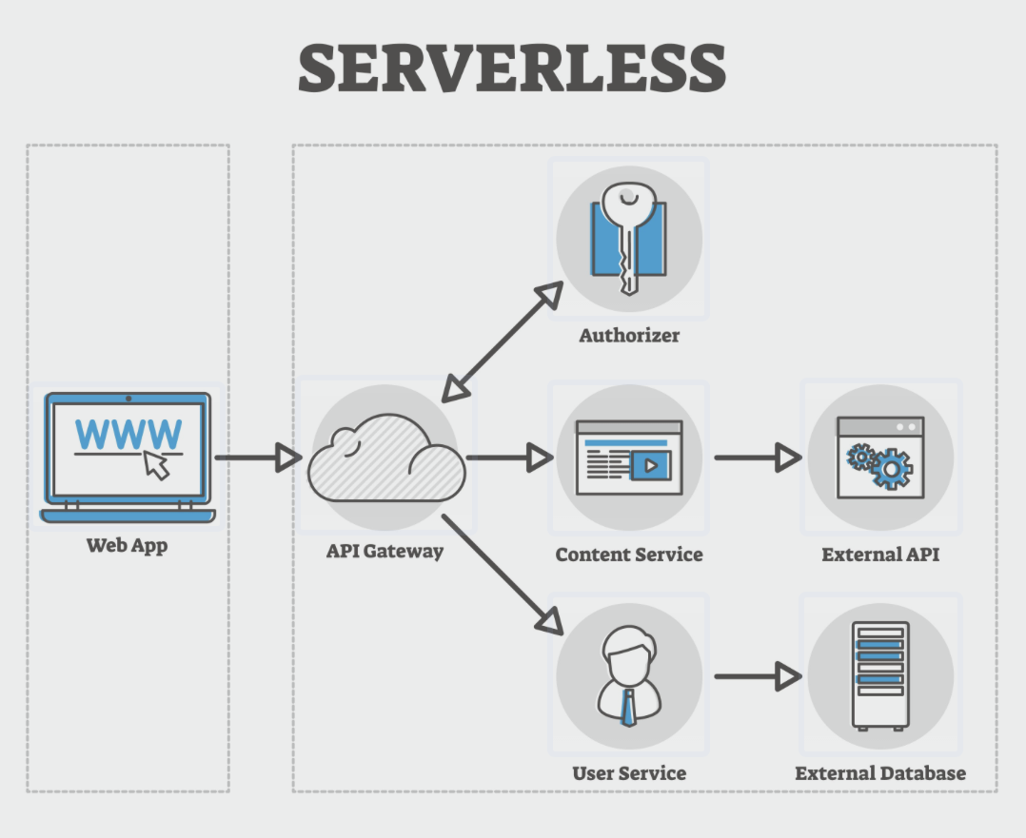


Tech Stack & Architecture
Frontend: JavaScript (ES6), CSS3 Variables.
Backend (BaaS): Google Firebase (v11) for Authentication and Firestore Database.
Security: Role-based access control (Admin vs. Student) via email domain validation.
Serverless Architecture
Integrations: Razorpay (Payments), EmailJS (Notifications), jsPDF (Document generation).

Slide 7
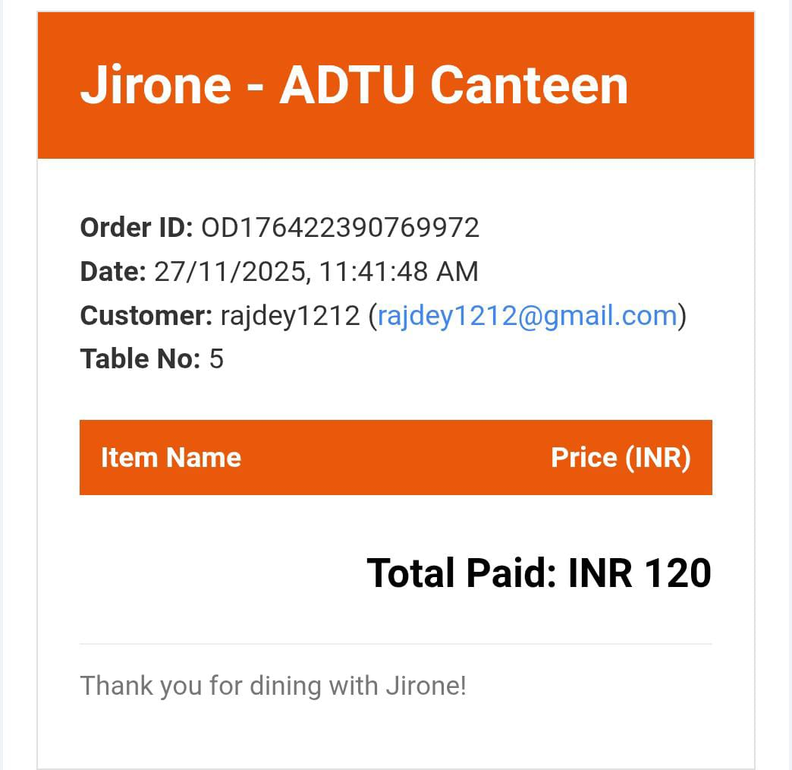
Automated Documentation
Jirone treats every order professionally. Upon successful checkout:
1.
PDF Generation: Client-side generation of a detailed invoice using jsPDF-autotable.
2.
Email Delivery: The PDF is attached and sent instantly to the student's registered email using EmailJS.

Slide 8
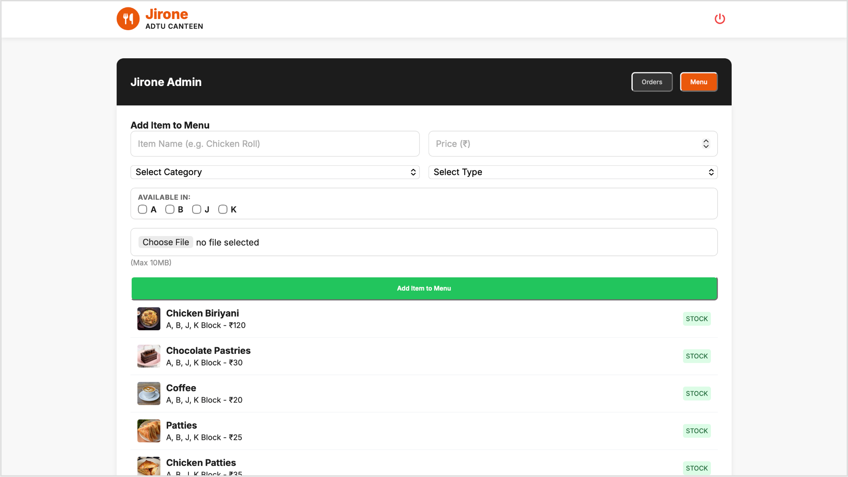

Admin Operations Center
Kitchen Management
Admins (authenticated via specific ADTU email domains) have access to a specialized dashboard to manage the canteen flow.
Order Management: View live orders, mark as "Ready", and trigger WhatsApp notifications.
Stock Control: Toggle menu item availability (Stock In/Out) instantly across all student devices.

Slide 9
Projected Impact
40%
100%
0
Reduction in Wait Time
Digital Record Keeping
Manual Calculation Errors

Slide 10
Future Roadmap
Pre-Ordering: Allow students to order food before class ends to pick up immediately.
Analytics Dashboard: Visual charts for admins to track peak hours and popular items.
Push Notifications: Native notifications when food is ready.

Slide 11

Questions?
Thank you for listening.
contact@jirone-adtu.in

